Slide 1
Seismic Slope Stability Analysis
CE 544 – BRIGHAM YOUNG UNIVERSITY

Slide 2
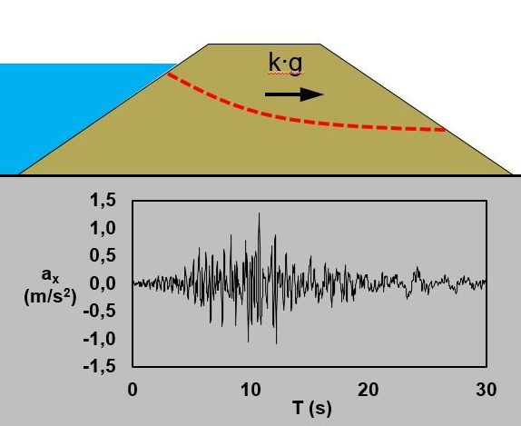
Introduction
Seismic slope stability should be evaluated for all slopes in seismically active regions
Earthquakes affect stability in two ways:
Reduced shear strength
Increased forces driving failure due to ground motion/horizontal acceleration

Slide 3
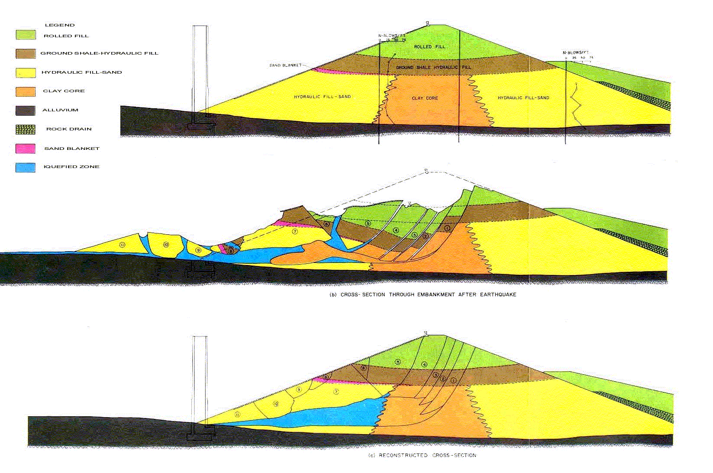
San Fernando Quake, 1971
Lower San Fernando Reservoir
Strength reduction due to liquefaction
Notes:
http://cabierta.uchile.cl/revista/8/seismic.html

Slide 4
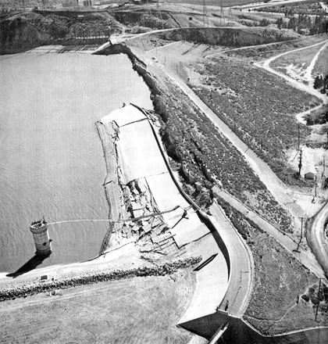
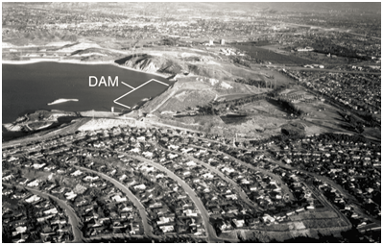
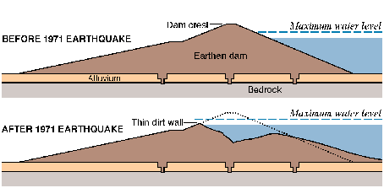
San Fernando Quake, 1971

Slide 5
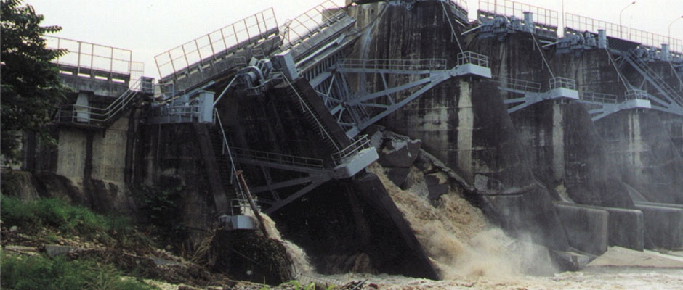
Introduction, Cont.
Two main types of analysis:
Comprehensive approach
Simplified (pseudo-static) approach
ShihKang Dam – Taiwan
Damaged in 921 Quake in 1999

Slide 6
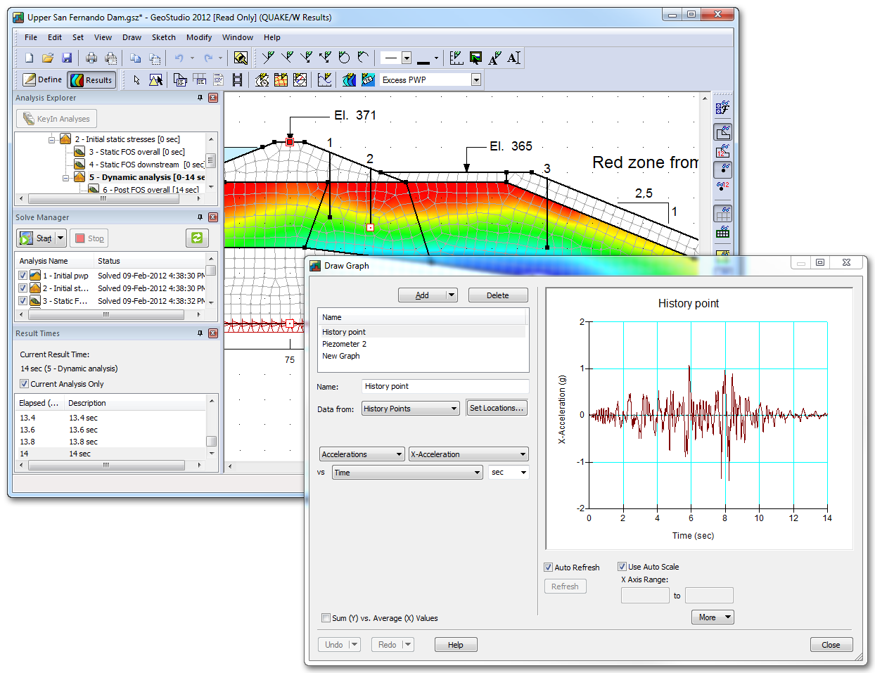
Comprehensive Approach, Cont.
Involves a finite element analysis of stresses and strains caused by acceleration time history. Resulting pore pressures and strengths are fed into limit equilibrium analysis to compute FS.

Slide 7
Pseudostatic Analysis
Earthquake loading is represented by a static force = k*W through center of gravity where k is a seismic coefficient
K is typically 0.05-0.25

Slide 8
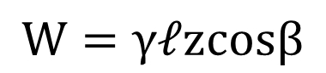
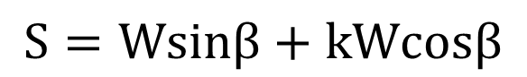
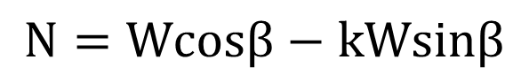
Infinite Slope
$$N=Wcosβ−kWsinβ$$
$$S=Wsinβ+kWcosβ$$
$$W=γ𝓁zcosβ$$

Slide 9
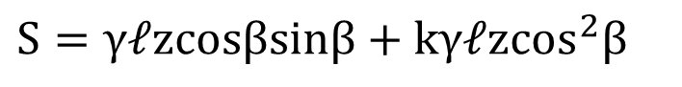
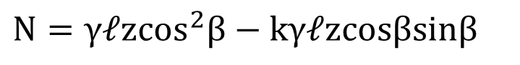
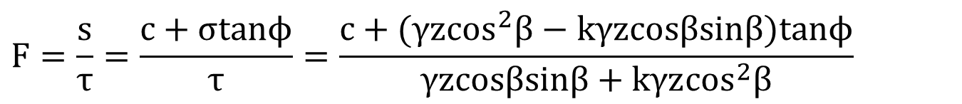
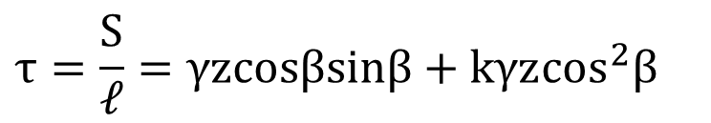
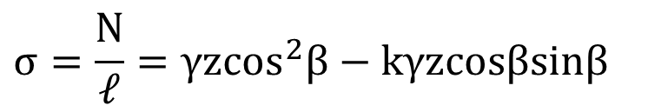
Infinite Slope, cont.
$$N=γ𝓁z\cos^{2}β−kγ𝓁zcosβsinβ$$
$$S=γ𝓁zcosβsinβ+kγ𝓁z\cos^{2}β$$
$$σ=\frac{N}{𝓁}=γz\cos^{2}β−kγzcosβsinβ$$
$$τ=\frac{S}{𝓁}=γzcosβsinβ+kγz\cos^{2}β$$
$$F=\frac{s}{τ}=\frac{c+σtanϕ}{τ}=\frac{c+(γz\cos^{2}β−kγzcosβsinβ)tanϕ}{γzcosβsinβ+kγz\cos^{2}β}$$

Slide 10
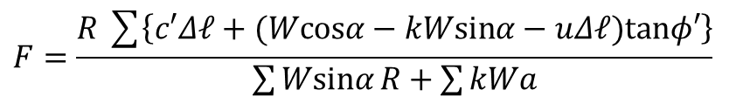
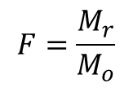
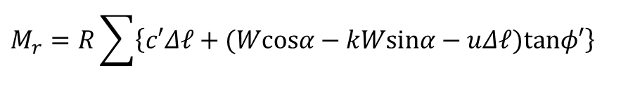
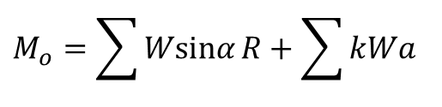
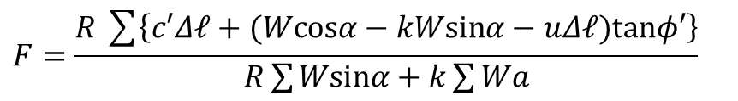
Ordinary Method of Slices (OMS)
$$M_{o}=\sum{Wsinα}R+\sum{kWa}$$
(a = moment arm for kW)
$$M_{r}=R\sum{\left\{c′Δ𝓁+(Wcosα−kWsinα−uΔ𝓁)tanφ′\right\}}$$
$$F=\frac{M_{r}}{M_{o}}$$
$$F=\frac{R\sum{\left\{c′Δ𝓁+(Wcosα−kWsinα−uΔ𝓁)tanφ′\right\}}}{\sum{Wsinα}R+\sum{kWa}}$$
$$F=\frac{R\sum{\left\{c′Δ𝓁+(Wcosα−kWsinα−uΔ𝓁)tanφ′\right\}}}{R\sum{Wsinα}+k\sum{Wa}}$$

Slide 11
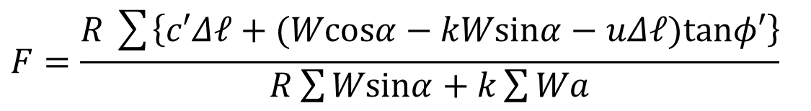
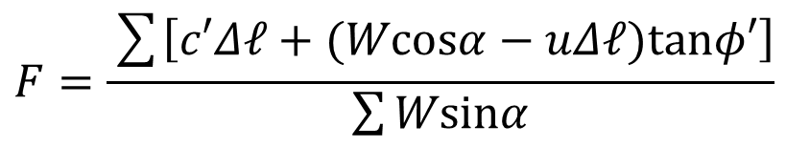
OMS – Compare Equations
Original:
$$F=\frac{\sum{\left[c′Δ𝓁+(Wcosα−uΔ𝓁)tanφ′\right]}}{\sum{Wsinα}}$$
Modified:
$$F=\frac{R\sum{\left\{c′Δ𝓁+(Wcosα−kWsinα−uΔ𝓁)tanφ′\right\}}}{R\sum{Wsinα}+k\sum{Wa}}$$

Slide 12
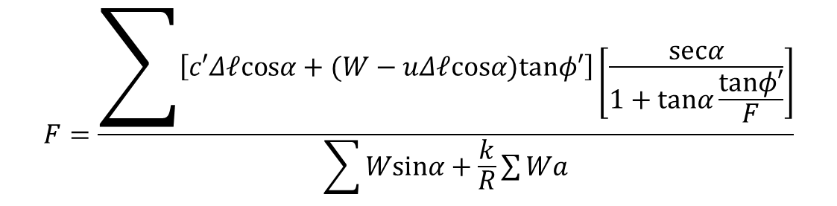
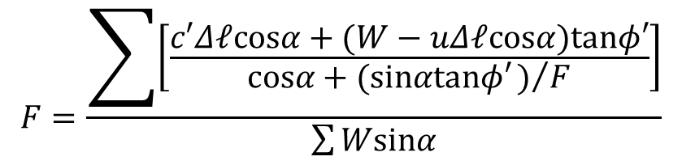
Bishop’s Simplified Procedure
Original:
$$F=\frac{\sum{\left[\frac{c′Δ𝓁cosα+(W−uΔ𝓁cosα)tanφ′}{cosα+(sinαtanφ′)/F}\right]}}{\sum{Wsinα}}$$
Modified:
$$F=\frac{\sum{\left[c′Δ𝓁cosα+(W−uΔ𝓁cosα)tanφ′\right]\left[\frac{secα}{1+tanα\frac{tanφ′}{F}}\right]}}{\sum{Wsinα+\frac{k}{R}\sum{Wa}}}$$

Slide 13
Pseudostatic Screening
Seismic Slope Stability Analysis

Slide 14
Pseudostatic Screening Analyses
Useful method for screening sites that are not expected to lose a large amount of strength during an earthquake
Components
Reference peak acceleration, a_{ref}
Acceleration multiplier
Shear strength reduction factor
Minimum factor of safety
Tolerable permanent deformation

Slide 15
1) Peak Acceleration, a_{ref}
Typically expressed as a fraction of gravity (a_{ref}/g)
Either the peak bedrock acceleration (PGA_{rock}) or the peak acceleration at top of slope (PGA_{soil}) determined from dynamic response analysis
PGA_{rock} can be found from: http://earthquake.usgs.gov/hazards/
Two cases typically analyzed:
10% probability of exceedance (PE) in 50 years
2% probability of exceedance (PE) in 50 years

Slide 16
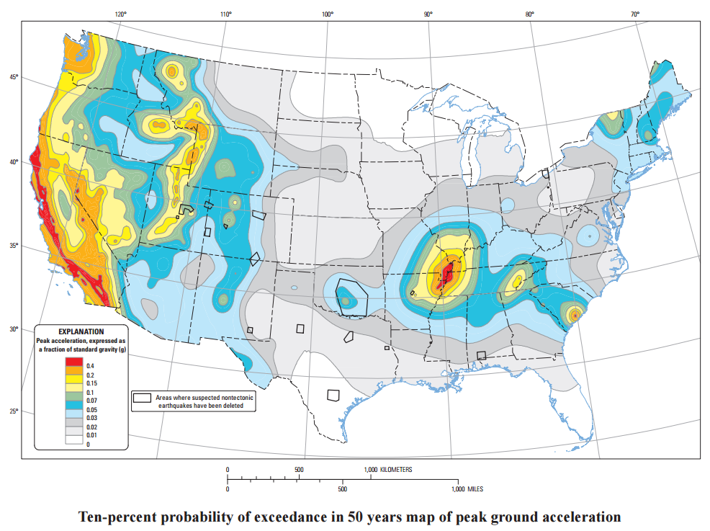
Notes:
https://earthquake.usgs.gov/static/lfs/nshm/conterminous/2014/2014pga10pct.pdf

Slide 17
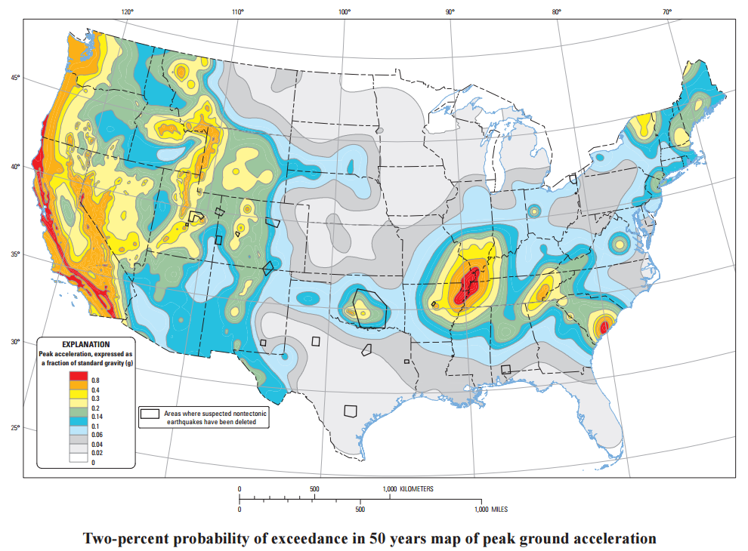
Notes:
https://earthquake.usgs.gov/static/lfs/nshm/conterminous/2014/2014pga2pct.pdf

Slide 18
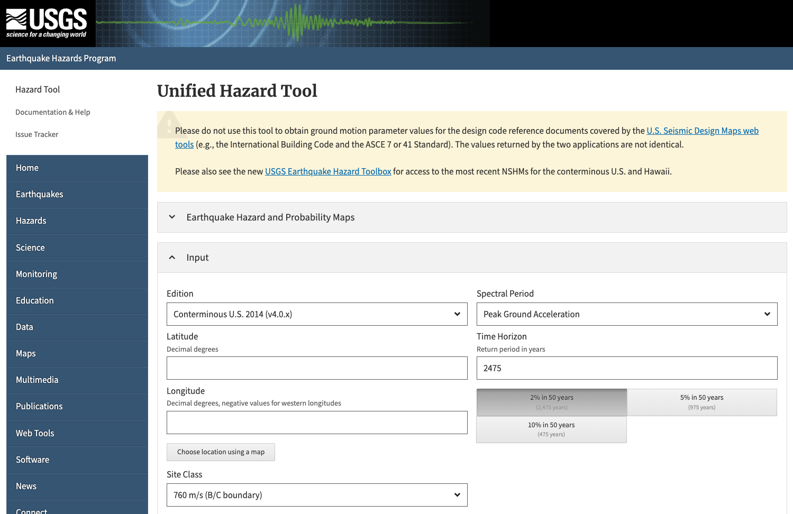
PGA for Specific Locations
https://earthquake.usgs.gov/hazards/interactive/

Slide 19
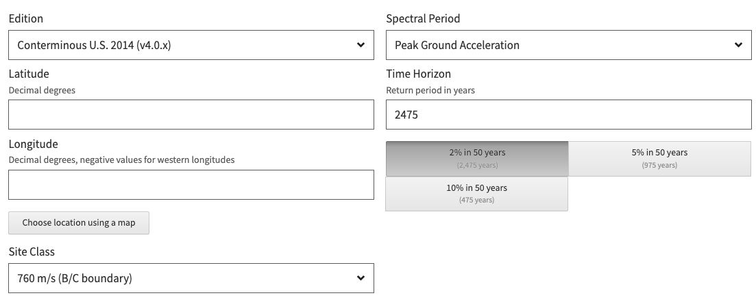
Pick your return period here
Click here to find lat/lon

Slide 20
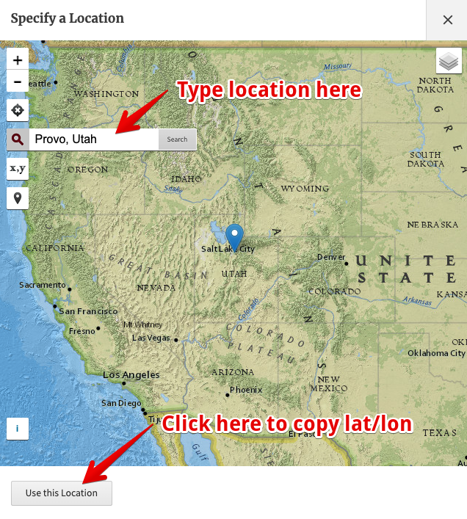

Slide 21
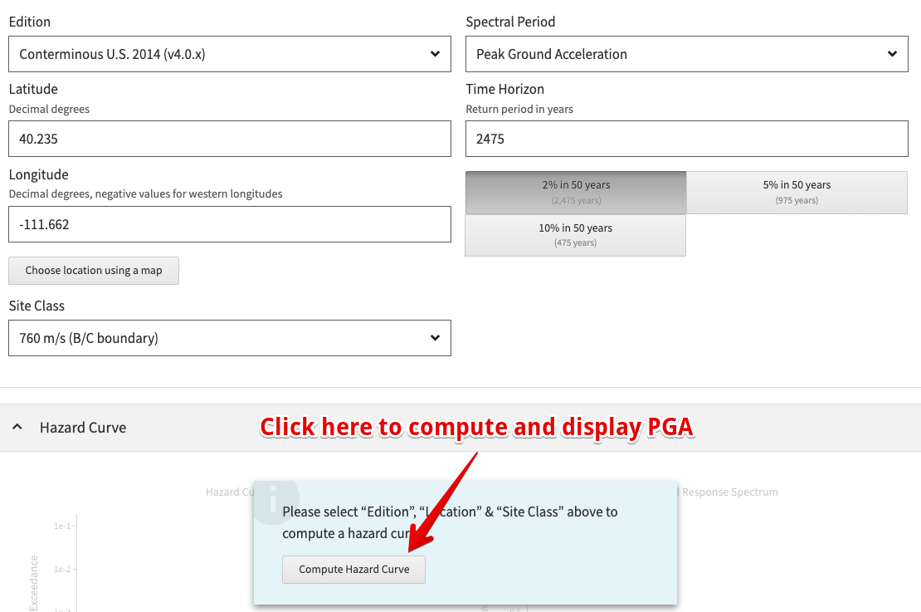

Slide 22
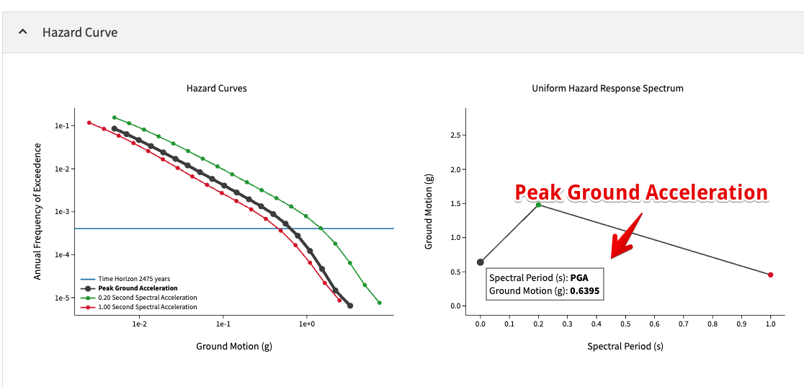
Click on alternate return period above and plot will refresh

Slide 23
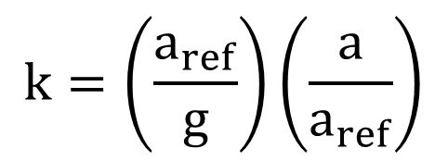
Determining k factor
$$k=\left(\frac{a_{ref}}{g}\right)\left(\frac{a}{a_{ref}}\right)$$
Where:
a_{ref}/g = peak acceleration
a/a_{ref} = acceleration multiplier
Acceleration multiplier is a scaling factor. Typically ~0.5 (see Table 10.1 in text)

Slide 24
3) Shear strength reduction factor
Makdisi and Seed (1977) found that non-liquefiable soils undergo small strains under cyclic loads when loaded to less than 80% of static strength
Thus, most experts recommend that static strength should be reduced by 0.8 when performing seismic analysis

Slide 25
4) Minimum factor of safety
Acceptable factor of safety for seismic analysis
Ranges from 1.0-1.15
(see table 10.1 in text)

Slide 26
5) Tolerable displacement
Maximum displacement expected if previous components are utilized/honored in the analysis
Ranges from 0.15-1.0 m
(see table 10.1 in text)

Slide 27
Shear Strengths
New Slopes – Short term (immediately after construction)
Total stress analysis
Unconsolidated-undrained tests
Existing Slopes – Long term (after equilibrium)
Total stress analysis
Unconsolidated-undrained tests
New Slopes – Long term (after equilibrium)
Use consolidated-undrained strengths
Two approaches
Two-stage analysis (similar to rapid drawdown)
Simplified procedure

Slide 28
Two-Stage Analysis
Similar to rapid drawdown approach
First stage
Based on static (pre-earthquake) conditions
Used to compute σ’_{fc} and τ_{fc} on failure surface.
Second stage
Effective stresses from stage 1 are used to find undrained shear strength, τ_{ff}.
FS is computed using τ_{ff} and loading conditions corresponding to earthquake (kW force added)

Slide 29
Simplified Procedure
Analysis is done in one step
Strengths are defined using R-envelope
FS is computed using loading conditions corresponding to earthquake (kW force added)
Even though the strengths from the R-envelope are undrained, pore pressures corresponding to pre-earthquake conditions must be used in order to ensure that proper effective stresses are found and fed into the R-envelope equation.

Slide 30
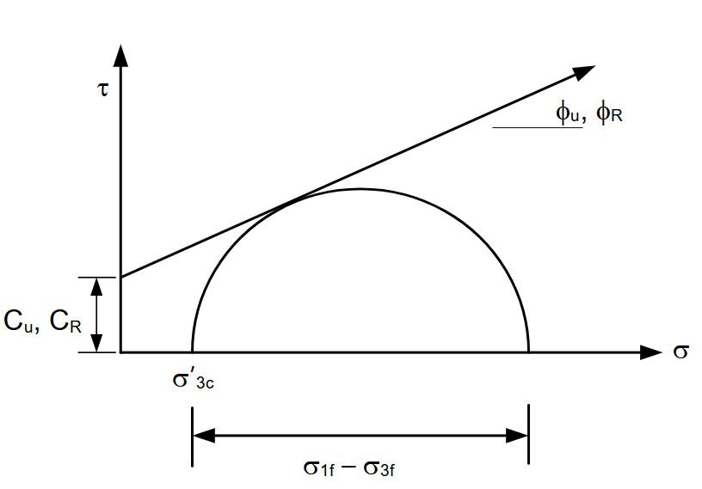
R-Envelope
Comparable to the τ_{ff} vs. σ’_{fc} curve used in rapid drawdown (the d-ψ curve), but a little more conservative. See figure 10.6 in text

